Slide 1


Optimizing User Engagement:
Insights from Social Buzz's Top Content Categories

Slide 2


Today's agenda
Project recap
Problem
The Analytics team
Process
Insights
Summary

Slide 3


Client: Social Buzz
Industry: Social Media & Content Creation
Founded: 2010, San Francisco HQ
250 Employees, 200 Technical Staff
Rapid Growth: 500M active users monthly
Data Volume: 100,000+ pieces of content posted daily
Project Recap
Notes:
Social Buzz is a rapidly growing social media platform that emphasizes content over user identity. Founded in 2010 and headquartered in San Francisco, the company employs 250 people, with 200 in technical roles. They have reached 500 million active users monthly, with over 100,000 pieces of content posted daily.

Slide 4


Problem
Preparing for IPO by next year
Limited resources to manage current scale
Need for best practices in handling big data
Notes:
Social Buzz is preparing for an IPO by the end of next year and needs guidance for a smooth process. They face challenges in managing their current scale due to limited resources and are seeking best practices in handling their massive amount of unstructured data.

Slide 5



ANDREW FLEMING
Chief Technology Architect
The Analytics team
MARCUS ROMPTON
Senior Principal
NIRANJANA
Data Analyst
Notes:
"Social Buzz's analytics team consists of 200 technical staff focused on data management. Given the highly unstructured nature of their data, they require sophisticated technology to manage and maintain it effectively."

Slide 6

Process
1
Data Understanding
2
Data Cleaning
3
Data Modelling
4
Data Analysis
5
Uncover Insights
Notes:
Data Understanding: We started by comprehending the structure, sources, and quality of the data, which is highly unstructured.
Data Cleaning: Next, we cleaned the data to remove inconsistencies, duplicates, and errors, ensuring accuracy for analysis.
Data Modelling: We then structured the data into a model suitable for analysis, making it easier to query and derive insights.
Data Analysis: Using advanced analytical tools, we examined the data to identify trends and extract meaningful information.
Uncover Insights: Finally, we uncovered actionable insights, providing recommendations to improve Social Buzz's content strategy and user engagement."

Slide 7


Insights
Identification of top 5 content categories
Popularity metrics across different content types
Data-driven recommendations for improvement
Notes:
"Our analysis identified the top 5 content categories with the highest aggregate popularity: Healthy Eating, Technology, Food, Science, and Animals. These insights reveal user preferences and offer data-driven recommendations to enhance content strategy and engagement."

Slide 8
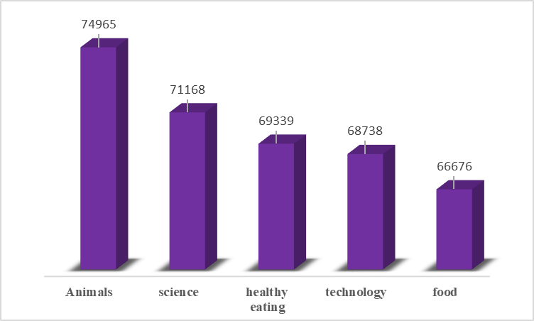
Notes:
"This bar chart provides a clear visual representation of the top five content categories on Social Buzz based on aggregate engagement.
Animals: Leading with 74,965 interactions, the Animals category shows the highest user engagement, indicating a strong community interest in animal-related content.
Science: Following closely, the Science category has 71,168 interactions. This suggests that users are highly engaged with scientific topics and discoveries.
Healthy Eating: With 69,339 interactions, the Healthy Eating category highlights the community's interest in health and nutrition, showcasing a trend towards wellness and healthy lifestyles.
Technology: At 68,738 interactions, the Technology category reflects significant user engagement with tech news, innovations, and trends.
Food: Finally, the Food category, with 66,676 interactions, underscores a strong interest in culinary topics, recipes, and food culture.
These insights confirm that while there is a diverse range of content on Social Buzz, topics related to animals, science, health, technology, and food resonate the most with users. Understanding these preferences will help in tailoring content strategies to maintain and enhance user engagement."

Slide 9
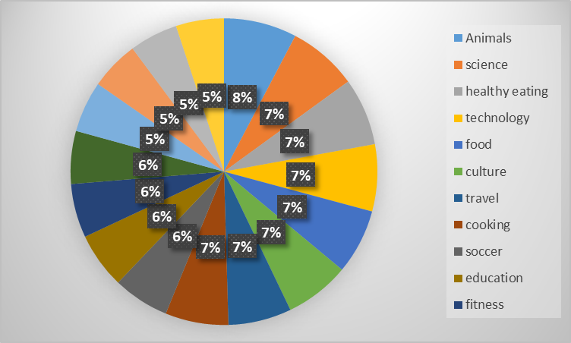
Notes:
"Our analysis of Social Buzz's content has revealed the top 5 categories based on aggregate popularity. As depicted in this pie chart, the top 5 categories are Healthy Eating, Technology, Food, Science, and Animals. These categories account for the highest levels of user engagement and reactions.
Healthy Eating: This category holds the highest popularity with 8% of total user interactions, indicating a strong user interest in content related to nutrition, recipes, and healthy lifestyles.
Technology: With 7%, this category includes content on the latest tech trends, gadgets, and innovations, appealing to tech-savvy users.
Food: Also at 7%, food content, which encompasses recipes, cooking tips, and culinary experiences, is a significant interest area for users.
Science: This category has a 7% share as well, reflecting user interest in scientific discoveries, experiments, and educational content.
Animals: With 5%, content related to animals, including pets, wildlife, and conservation, captures considerable user attention.
These insights provide a clear understanding of what types of content resonate most with Social Buzz's audience. By focusing on these categories, Social Buzz can tailor its content strategy to enhance user engagement and satisfaction."

Slide 10


Successful Audit and Data Analysis
Summary
Recommendations for IPO
Key Insights on Content Categories
Notes:
"To summarize:
We conducted a successful audit of Social Buzz's big data practices and analyzed their vast data effectively.
Provided strategic recommendations to ensure a smooth IPO process.
Identified key insights on content categories, highlighting the top 5 with the highest aggregate popularity.
Suggested technical enhancements and shared best practices for data management, learned from large corporations, to help Social Buzz handle big data challenges more effectively."

Slide 11

Thank you!
ANY QUESTIONS?

